Slide 1
Workforce Planning for General Practice
Webinar / Discussion
January 2025

Slide 2
Contents
The importance of Workforce Planning
Approach to workforce planning
Understanding your drivers
Supply Analysis
Demand Analysis
Gap Analysis
Solution Formulation and Implementation
Monitoring and Evaluation
Summary
Templates and Tools

Slide 3
1. Understanding your Drivers
Staff
Morale
Wellbeing
Personal and Professional Development
Agility
Local Community
Mortality rates
Reduced inequalities
Improved wellbeing
Improved Staff Experience
Improved Patient Experience
Value for Money
Improving Health Outcomes
Taxpayers / Business
Efficiency
Productivity
Financial balance
Sustainability
Reduction of waster
Service Users
Safe
Effective
Efficient
Timely
Equitable
Patient-centred
Institute for Healthcare Improvement, 2014
Notes:
Triple aim is an approach to optimising health system performance – the primary aim being to improve the health of the population
Did not acknowledge that workforce is the backbone of health and care services and achieving triple aim is not possible without a happy and engaged workforce
Therefore, quadruple aim was proposed

Slide 4


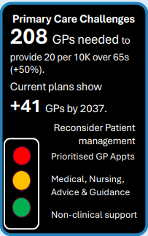


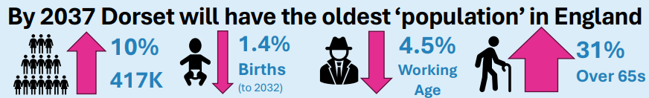
Short and Long-term Drivers
Dorset System Stratetic Aims
Integrated Neighbourhood Teams
Today’s decisions impact Tomorrow’s workforce – aim to plan beyond each financial year
& fixed horizons to enable a medium-long term workforce strategy.
Notes:
1. Contracts - triangulation of required activity, finance and workforce to deliver services in the here and now
2. The workforce should align to the 7-rights.
3. Understanding future demand projections and requirements – inc NHS LTWFP
4. Understanding the strategic aims of our system – transformation and integrated neighbourhood teams - there is agreement that we will use GP practices, as the building block for integration and group them within the existing PCN areas. The rationale being that, while not perfect, GP practices are closely connected to communities – they tend to know the people in the community and the people in the community tend to know their GP practice

Slide 5
Strategic Drivers
What direction is your organisation going?
Understand key mission goals and future objectives set by the organisation and how the workforce needs to be aligned to achieve them. E.g., Short-term drivers, Integrated Neighbourhood Teams and change in commissioning intent
Questions to consider:
What are the expected programme changes over the next 1-3 years? What will drive these changes?
What are the short-term and long-term plans/strategies?
What are the specific workforce challenges the organisation is expected to face in the short and long-term?
What challenges exist in the emerging market, economic and political environments?
What legislative, policy or regulatory changes may impact your organisation / programme?
Notes:
What are some of the short-term drivers in general practice?

Slide 6
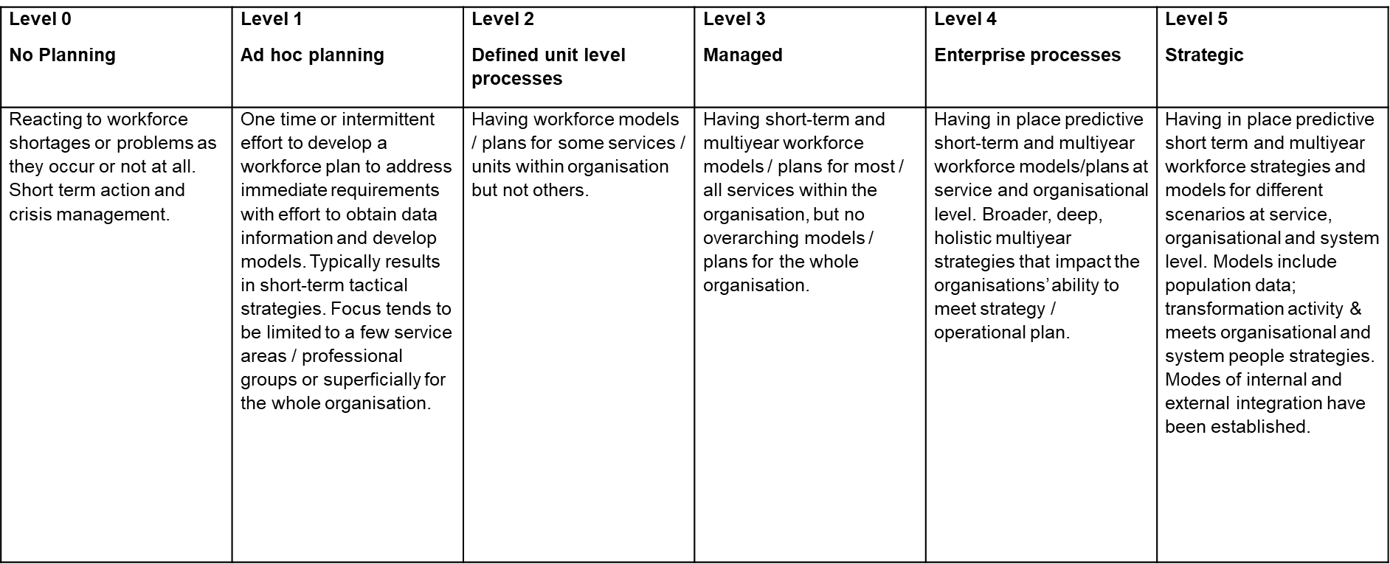
Workforce Planning Maturity – Self-Assessment
The LGA Workforce Planning Maturity Matrix

Slide 7

2. Supply Analysis
What is your workforce supply?
Conduct a supply analysis to understand the current workforce and how
it is projected to change over time
This phase is about painting a picture of the workforce – 7-Rights.
Questions to consider:
How well does the current workforce align/support?
How many employees are at each band? Is this an appropriate mix?
What are your turnover rates? How will turnover affect the ability to deliver services?
What is the current distribution of employees years of service?
How many of the workforce will be eligible for retirement in the coming years? Are these individuals in leadership/critical/hard to fill positions?
Will employees who have left be replaced? If so, will it be via internal or external recruitment?
What are the costs of replacing talent internally vs externally?
Do you have persistent vacancies / hard to recruit to roles?

Slide 8

Data – Understanding the profile and trends of workforce
Number and types of employees
Salary / Benefits / Grade
Workforce demographics (age, gender, race, etc)
Years of service
Competencies
Location
Turnover data
Vacancies
Sickness absence
Notes:
SUPPLY TAPS - Newly Qualified Staff, Return to Practice. NHS Joiners, International Recruitment. Apprenticeships
SUPPLY LEAKS – Retirements, Leavers to NHS, Leavers from NHS, Reduced Hours
How do we influence inflow and outflow
Placements
Preceptorship/Mentorship
Environment
Conditions
Culture
Flexibility
Job Descriptions
Pay
Future Prospects/Opportunities
Appraisals
CPD/Training
Upskilling
Accommodation
Car Parking
Thanks/Rewards
Responsibility

Slide 9

3. Demand Analysis
What is the workload demand?
What is the amount and type of work historically / currently handled?
How will demand change in the future?
Is there unmet need?
This information can be used to project the number of staff resource
(HC and skill) needed to perform work in various job functions, taking into consideration current workload, finance and emerging drivers.
Questions to consider:
How is workload measured? What are the units of measurement?
How many people does it take to accomplish the work? Is this anticipated to change in the future due to efficiency gains or service change?
Based on the strategic plan / programme, how is the work anticipated to change over the next few years?
Does the supply of employees meet the anticipated demand?
Notes:
INTS - ‘As Is’ staff, however the ‘To Be’ model will need to address gaps in service provision and unwarranted variation to match local population need to the appropriate skills and resources.

Slide 10
4. Gap Analysis
What workforce gaps do you have?
Understanding the gaps between workforce demand and supply allows us to prioritise the gaps that will have the greatest impact on organisational performance.
Depending on your supply and demand analysis, you could have workforce gaps in different areas of skill, competency, staff numbers, location, occupations, etc.
Questions to consider:
What gaps do you see between your supply and demand data?
What gaps are most critical for day-to-day delivery?
What gaps are most critical considering the strategic aims / goals of the programme?
How would you prioritise your gaps in terms of what to address first?
Which gaps are most difficult to close? Easiest?
Do some gaps have more of an impact on organisational performance than others?
Common types of workforce gaps:
Skills – current staff do not have the skills needed to accomplish the work
Staffing level – current staffing levels do not meet the required workload demand.

Slide 11
5. Solution Formulation and Implementation
What is the appropriate solution?
Consider your supply & demand and critical gaps, what are the appropriate workforce interventions to close those gaps and enable your organisation to meet its strategic goals.
Training / new roles / upskilling / business case (inc. impact assessment / additional funding / leadership / new ways of working
Questions to consider:
What existing workforce interventions can you leverage?
Do you have multiple critical gaps? Do you need a multi-pronged approach?
What factors might impede the success of your strategy?
What will the short-term implementation activities be?
What will the long-term activities be?

Slide 12
6. Monitoring and Evaluation
Is the strategy working?
Reflect back on the WF interventions, how do you know if it has worked?
Monitor the performance of your WF planning solutions and the impact they have on the gaps they were designed to address. It may be necessary to modify or change the intervention.
Questions to consider
How will WF solutions be monitored and progress measured? What metrics or KPIs will be used?
What are the implementations critical success factors?
How will revisions to the approach be implemented?
Have there been changes in the internal or external environment that would suggest a revision to the plan?
Are there established processes to collect relevant data and trends for this plan?
Suggestions for evaluation:
Program process reviews
Staff survey / pulse / appraisal
Lessons learned sessions

Slide 13
In Summary
An evidence based, robust and predictive short-term and multi-year workforce plan will …
Support operational delivery
Support long-term strategic aims
Improve capacity & capability
Identify workforce supply risks
Identify skills gaps - right skill, right place, right cost
Highlight career development opportunities
Identify workload imbalances and bottlenecks
Help to create a sustainable and agile workforce
Improve efficiency & effectiveness
Reduce Health Inequalities
Underpin funding streams and ultimately commissioning intent (INTs)
Support role definition
Improve data maturity
Inform placement / supervisory demand and capacity

Slide 14
Tools and Templates
Operational workforce planning
Strategic workforce planning, shaping and commissioning
NHS England » Workforce planning and resource management
Understanding workforce planning
STAR Transformation Methodology
Workforce Plan on a Page Template
Task Analysis
Pestle Analysis
Seven Rights
Six Thinking Hats
SOAR/SWOT
Drivers and Constraints
Functions Gap Analysis
Risk Log
Tools, resources and links to databases can be found at FutureNHS - Dorset ICS Workforce Planning Community of Practice

Slide 15
References
Alderwick, H. and Charlesworth, A. (2022) 'A long term workforce plan for the English NHS', BMJ (Online), 377, pp. o1047-o1047.
Anderson, M., O'Neill, C., Macleod Clark, J., Street, A., Woods, M., Johnston-Webber, C., Charlesworth, A., Whyte, M., Foster, M., Majeed, A., Pitchforth, E., Mossialos, E., Asaria, M. and McGuire, A. (2021) 'Securing a sustainable and fit-for-purpose UK health and care workforce', The Lancet (British edition), 397(10288), pp. 1992-2011.
Fraher, E. and Brandt, B. (2019) 'Toward a system where workforce planning and interprofessional practice and education are designed around patients and populations not professions', Journal of interprofessional care, 33(4), pp. 389-397.
Hurst, K. and Kelley Patterson, D. (2014) 'Health and social care workforce planning and development – an overview', International journal of health care quality assurance, 27(7), pp. 562-572.
Hurst, K. and Patterson, D. (2014) 'Health and social care workforce planning and development – an overview', International journal of health care quality assurance, 27(7), pp. 562-572.
Torjesen, I. (2022) 'Rising cost of living is worsening NHS workforce crisis and workload', BMJ (Online), 378, pp. o2364-o2364.
Waitzman, E. (2022) 'Staff shortages in the NHS and social care sectors', House of Lords Library 2023].
Waters, A. (2022a) 'Former NHS boss accuses government of “wilful blindness” over workforce planning failures', BMJ (Online), 376, pp. 227-227.

